Slide 1
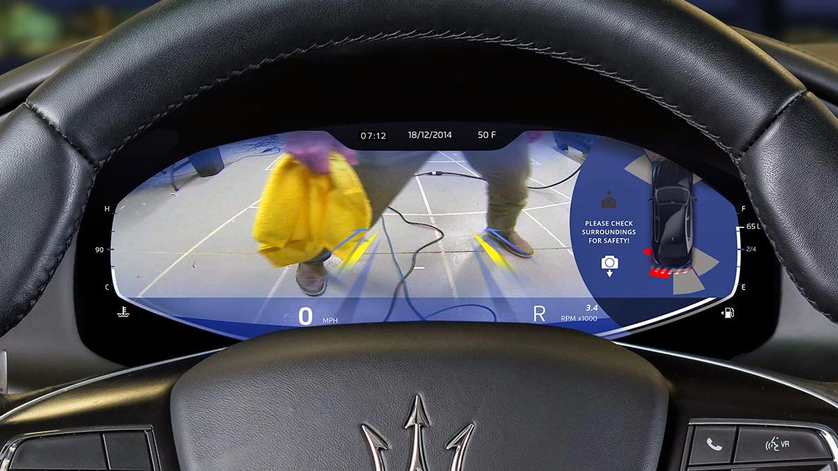

Introduction to Game Theory
Sarder Rafee Musabbir
Supervisor: Prof. Michael Zhang
University of California, Davis

Slide 2
Outline
Outline
Game Concept
Game Framework
Game Dynamics
Player Dynamics or State and Control
Payoff / Cost Function / Objective Function
Nature of Interaction: Cooperative, Competitive
Game Strategy or Information system: Feedback
Equilibrium Solution: Nash Eq.

Slide 3
Game Concept
Game Concept
Game theory is the study of mathematical models of conflict and cooperation between rational decision-makers. It is concerned with the study of strategic decision making among multiple players (often called agents).
Each player chooses from a set of available actions (often called alternatives) to maximizethe payoff (objective function in this case is called utility or reward) or to minimize it (cost function or loss).
The payoff of a player depends also on the other players’ actions. This means that is not convenient (or rational) for the individual players to blindly optimize their objective without considering how the others would act.

Slide 4
Game Concept
Game Concept
Static Games: Look at games when they happen once, and everybody must make their decisions at the same time.
Dynamic Games: Look at games that do not happen all at once. A dynamic game is one in which players move sequentially or repeatedly.
Auctions: Auctions are a type of game when bidders need to strategically select the best bid.

Slide 5
Game Elements
Game Concept
Elements
the players, i.e., the agents that take the decisions and have an individual preference on the outcome of the same
Strategies: What are the options of each player? In what order do players act?
the information structure that specifies what information is available at each player before making their decision (for example, other players’ decisions)
the outcome of the game, which in general depends on all players’ decision or rationality.

Slide 6
Cooperative vs Non-cooperative
Game Concept
Nature of Interaction
A major distinction in the field of game theory is based on whether the players can enter into a cooperative agreement.
If cooperation is possible, this would imply that the decision making is carried out collectively and everyone would benefit to the possible extent without any inefficiency in the system. This is known as cooperative game theory, which deals with issues of bargaining, coalition formation, excess utility distribution, etc.;
In the noncooperative game, each player carries out the decision-making process individually based on the information available (this includes also a decision-making model of the others) till there is no incentive anymore to change their decision. (Nash Equilibrium).
Notes:
Nash Equilibrium represents a situation in which every player has no incentive to unilaterally deviate from the current strategy. Loosely speaking, it describes the best payoff that each player could expect if all are behaving rationally.

Slide 7
Zero-sum vs General-sum games
Game Concept
Advantage
A remarkable distinction can be drawn between scenarios that are intrinsically adversarial (such as racing) and others that are not (e.g. urban and highway driving).
A race is inherently a zero-sum game: there is a winner and the losers (or multiple tiers of winners). The “outcome of a race” depends on the joint state which defines a winner (+1) and a loser (−1). Zero-sum games are the ones in which one players’ payoff is equivalent to another’s loss.
Nevertheless, racing scenarios do not describe the interaction of multiple robots simply sharing the same workspace. For instance, in every-day urban driving agents have personal objectives (where to go, driving style preferences,...) but also coupled objectives (avoid collision, keep safety distance,...); all these do not sum to zero in general, hence the name general-sum games.
Notes:
Nash Equilibrium represents a situation in which every player has no incentive to unilaterally deviate from the current strategy. Loosely speaking, it describes the best payoff that each player could expect if all are behaving rationally.

Slide 8
Playing Sequence
Game Concept
Playing Sequence
Another aspect that defines the type of game is the playing sequence of the players. simultaneous or sequential play
Simultaneous play assumes that the players choose their actions at the same time independently.
Sequential play assumes that the players take turns in selecting their actions, thus they can observe the actions of all the other players before deciding on their specific action. Sequential games have a “simpler” structure which is well suited for poker, chess, etc.
Sequential games could be meaningful in driving scenarios when there is an inherent asymmetry in the scenario. For example, at a stop-sign intersection one could model the approaching vehicle from the right as a leader and the vehicle that yields the right of way as the follower giving rise to a particular class of games called Stackelberg games.

Slide 9
Playing Sequence
Game Concept
Playing Sequence
Agents in the real world may or may not take decisions at the exact same instant and they do not necessarily have a fixed playing sequence.
In a bid to describe what happens in the real world one should model agents taking decisions asynchronously with a delay on observations of the others’ actions. Despite this consideration, the above scenarios are good approximations to capture the structure of the game.

Slide 10
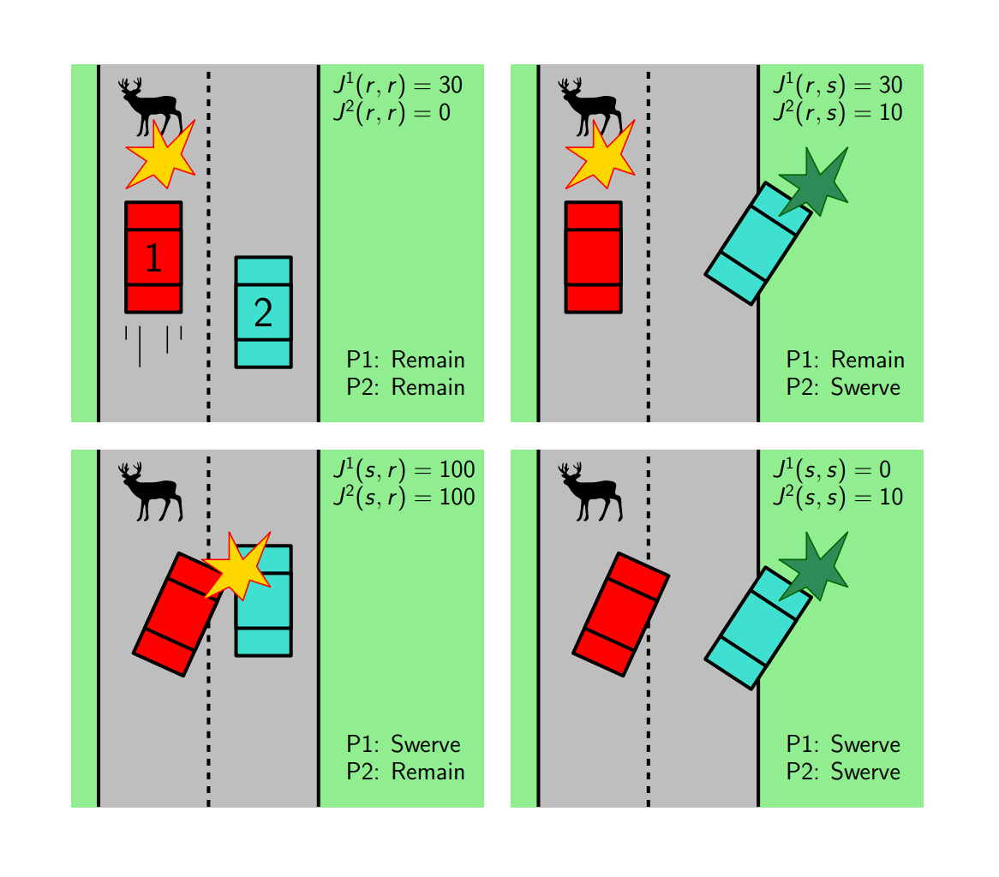
Game Example
Game Example
Elements
Example: (Emergency maneuver).
Consider the decision problem where, the players in this game are the two drivers, and they have the same actions available to them: to remain in their lane or to swerve to the right.

Slide 11
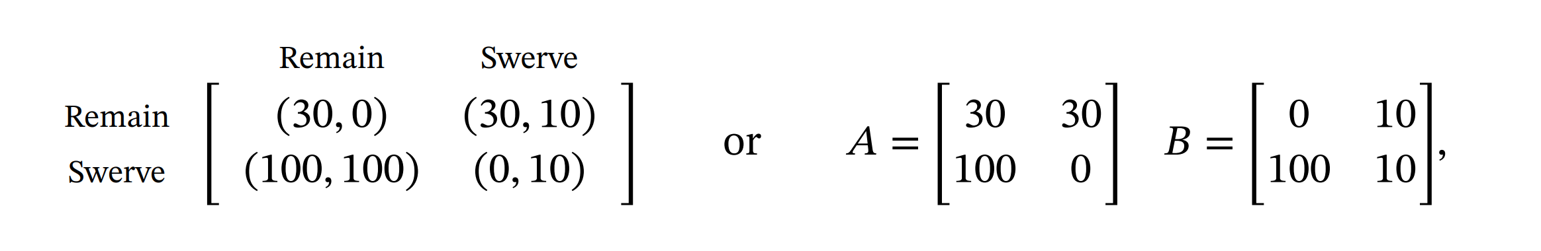
Game Example (contd.)
Game Example
Example
Example: (Emergency maneuver).
The information structure in this game is very simple - both players need to take a decision at the same time, without knowing what the other player has decided (simultaneous play). The outcome of the game is represented via a cost, which could describe the resulting damage suffered by each of the players’ cars.
where each element of the matrix corresponds to the resulting outcome for the two players:
A_{ij} = J¹(a_{i} , b_{j}) , B_{ij} = J²(a_{i} , b_{j})
Notes:
Games with two players, a finite number of actions, and simultaneous play, are often represented via their matrix form.

Slide 12
Best Responses and Nash Equilibria
Game Example
Example
Once a game is defined, we face the problem of solving the game. The interpretation of such a task differs depending on the specific application:
⊳ In some applications, we are interested in predicting the decision that agents will make, under the assumption that these agents are rational, informed of the rules of the game, and interested in achieving the best possible outcome;
⊳ In some other applications agents are expected to collaborate in order to take joint decisions that exhibit some desirable properties; the formalization of the decision problem as a game is an instrumental step in order to identify the desired joint decision and to design computational approaches for the solution of the game.

Slide 13
Best Responses and Nash Equilibria
Game Example
Example
Solving a game consists in identifying joint players’ decisions such that
⊳ no player can improve their own outcome by changing their decision;
⊳ equivalently, no player regrets their decision after observing the outcome;
⊳ if players were to repeat the game, they would make the same decision. The technical concept that formalizes this idea is based on the definition of what is the player best response to the other players’ decisions.

Slide 14
Game Example
Game Example
Elements
Example: (Emergency maneuver contd.).
Consider the decision problem where, the players in this game are the two drivers, and they have the same actions available to them: to remain in their lane or to swerve to the right.

Slide 15
Best Responses and Nash Equilibria
Game Example
Example
Example (Emergency maneuver, cont.). Let us consider the same game as in the previous Example and identify the best responses for the two players.
⊳ Player 1’s best response is defined element-wise as
R¹(remain) = remain, R²(swerve) = swerve
⊳ Player 2’s best response is defined element-wise as
R²(remain) = remain, R¹(swerve) = swerve
By simple inspection, we can identify two Nash equilibria:
⊳ (remain, remain), with outcome (30, 0)
⊳ (swerve, swerve), with outcome (0, 10)
⊳ Notice that the two Nash equilibria are not interchangeable, i.e., (remain, swerve) and (swerve , remain) are not Nash equilibria.

Slide 16
Equilibrium selection and admissibility
Game Example
Example
As observed in the previous example, games may admit multiple Nash Equilibria.
A natural question is how to predict which equilibrium players will choose (if we are using the concept of Nash equilibria as a predictive modeling tool) or which Nash equilibrium to prescribe. A partial answer is provided by the concept of admissibility.
The two Nash equilibria that we computed in Example are both admissible, as the two corresponding outcomes are not comparable
The fact that the admissible Nash equilibrium for this game is not unique captures the difficulty of predicting (or agreeing on) the behavior of rational agents in this game

Slide 17
Congestion games
Game Type
Congestion Games
Congestion games are a class of games that abstract an extremely wide selection of problems in engineering, including problems in robotics, communication, and control.
The main elements of a congestion game are its N players, and the set ℳ = {1, … , M} of resources. A player’s strategy corresponds to a subset of resources that the player will use:
G^{i} ⊆ ℳ G = strategy of player
Consequently, each resource may be used by one or more players, and we define the load on resource j as the number of players who use it L_{j}(a) := |{ i | j ∈ a^{i} }|
The cost incurred by each player depends on the load on the resources that the player is using, i.e., J^{i} (a) = ∑ f_{j} (l_{j}(a)) where the function f_{j} is resource-specific, non-decreasing, and the same for all players.

Slide 18
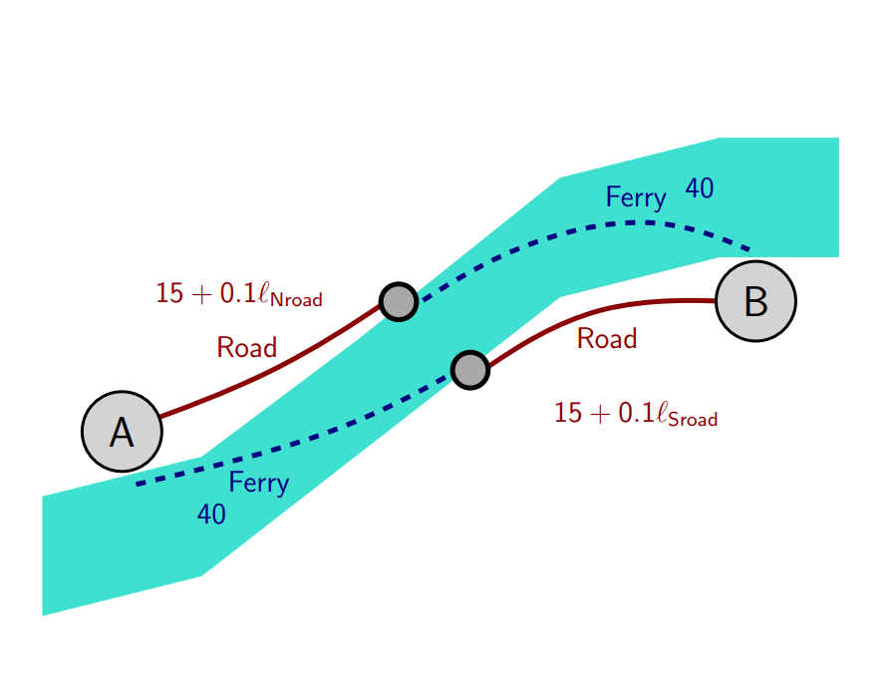
Congestion games: Routing game
Game Type
Congestion Games
Example (Routing game). Suppose there are two ways to reach city B from city A, and both include some driving and a trip on the ferry. The two paths are perfectly equivalent, the only difference is whether you first drive, or take the ferry. The total time needed to complete the trip depends on what other travelers do.
⊳ The ferry time is constant, 40 minutes
⊳ The road time depends on the number of cars on the road.
We consider N = 200 travelers, each of which is trying to minimize their travel time.

Slide 19
Congestion games: Routing game
Game Type
Congestion Games
This game is clearly a congestion game, with four resources (N ferry, N road, S ferry, S road), 200 players, and a resource cost f_{j} (l_{j}) that describes the time spent on the resource j.
The actions available to each player are, a^{i} = {N road, N ferry, S road, S ferry}
and all players have the same cost function,
J^{i} (a^{i} , a^{-i}) = 40 + 15 + 0.1 l_{N road} and
J^{i} (a^{i} , a^{-i}) = 40 + 15 + 0.1 l_{S road} when a^{i} = North and a^{-i} = South

Slide 20
Congestion games: Routing game
Game Type
Congestion Games
The equilibria of the best-response dynamics are all strategies where half of the players use the North path, and half of the players use the South path, yielding a travel time of
In any other partitioning of the agents there would be at least one agent that could improve their cost by changing strategy.
There are however mixed Nash equilibria as well: the simplest to find is the one where all players select one of the two paths with probability 50% (but many others exist).

Slide 21
Congestion games: Routing game
Game Type
Congestion Games
Nash equilibria of a congestion game do not correspond to efficient use of the resources by the users.
This inefficiency if quantified by the so-called price of anarchy, defined as the ratio
where Γ is the set of all possible strategies for all agents while Γ_{NE} is the set of all strategies which are Nash equilibria.

Slide 22
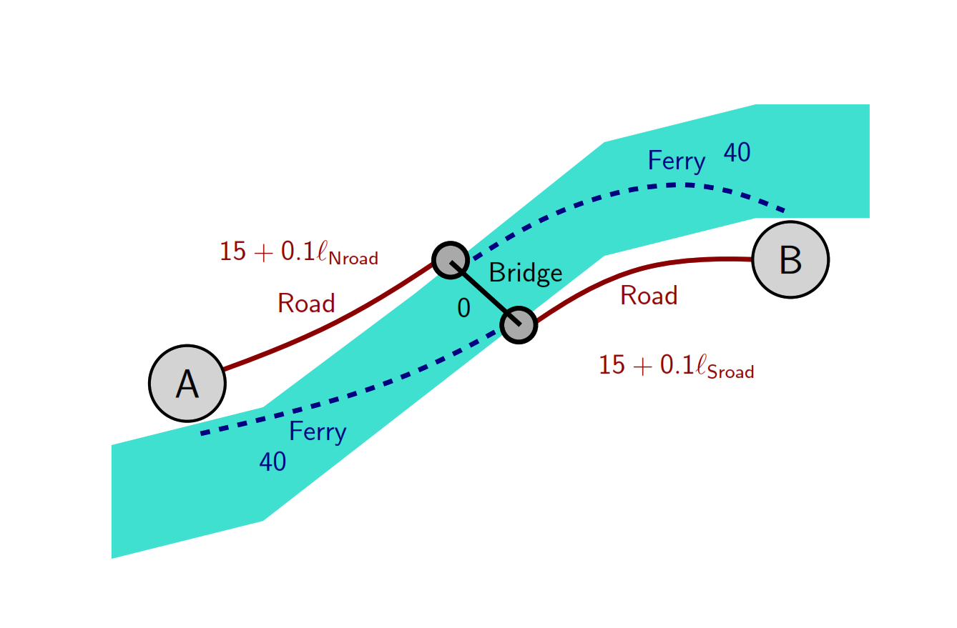
Congestion games: Braess Paradox
Game Type
Congestion Games
(Braess Paradox). Consider a variation of the routing game, where a bridge is now available to cross the river
The bridge is ideal: it has no capacity constraints, and it takes not time to cross it (no matter how many people use it).

Slide 23
Congestion games: Routing game
Game Type
Congestion Games
A new Nash equilibrium emerges, in which all players use both the North and South roads together with the bridge. Their total travel time therefore amounts to
using the ferry will yield a travel time of
the new travel time is larger than the travel time that agents achieved at the Nash equilibrium
when no bridge existed (65 minutes), even if those strategies are still available to the players.

Slide 24
Congestion games: Routing game
Game Type
Congestion Games
The resulting price of anarchy
social-optimal strategy at the denominator

Slide 25

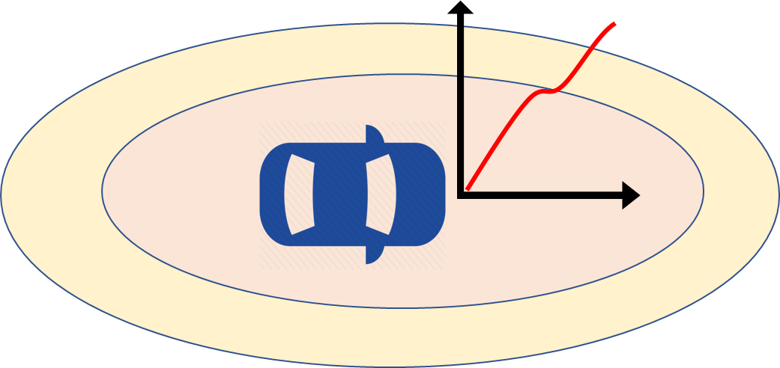
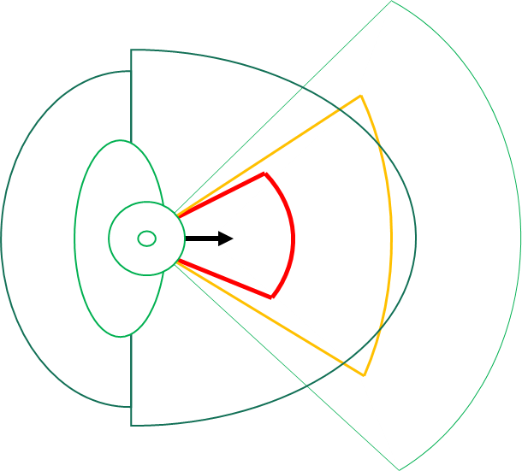
Game Framework
Framework
Player-1 Model
Nash or Stackelberg or Bayes Equilibria Solution
Game Framework
Information System (Feedback and Asymmetric)
Cost Function or Payoff for each player
Terminal Condition for a Finite Horizon Game
Player-2 Model

Slide 26
Game Strategy or Information System
Framework
Strategy
OPEN LOOP : player i cannot make any observation of the state z, or of the strategy adopted by other player. v(t) = (z₀ ; t) where, v(t) is the information available at time t.
FEEDBACK : player i can make observation of the state z for each period t. but not any strategy adopted by other player. Based on the observation of each period, the player i can opt for different strategies, v(t) = (z(t) ; t).
HIERCHICHAL PLAY : Player-1 (leader) announces its strategy in advance such that player-2 (follower) has the complete information of the state. Task of Player-1 is to devise a control strategy u₁ = u₁ (t ; z) such that the reply u₂ of the other player yields a max payoff (for Player-1).

Slide 27
Game Strategy or Information System
Framework
Strategy
DELAYED INFO. : each player cannot observe the state z(t), budgets information of other player’s actions with a time delay t > 0. Suitable for cooperative agreements between the two players with a punishment strategies for the player who deviates from the agreed course of action.
ASYMMETRIC : one player has complete information of the state unlike the other player. These information strategies are studied case by case basis. There is no general formulation like open-loop or feedback.

Slide 28
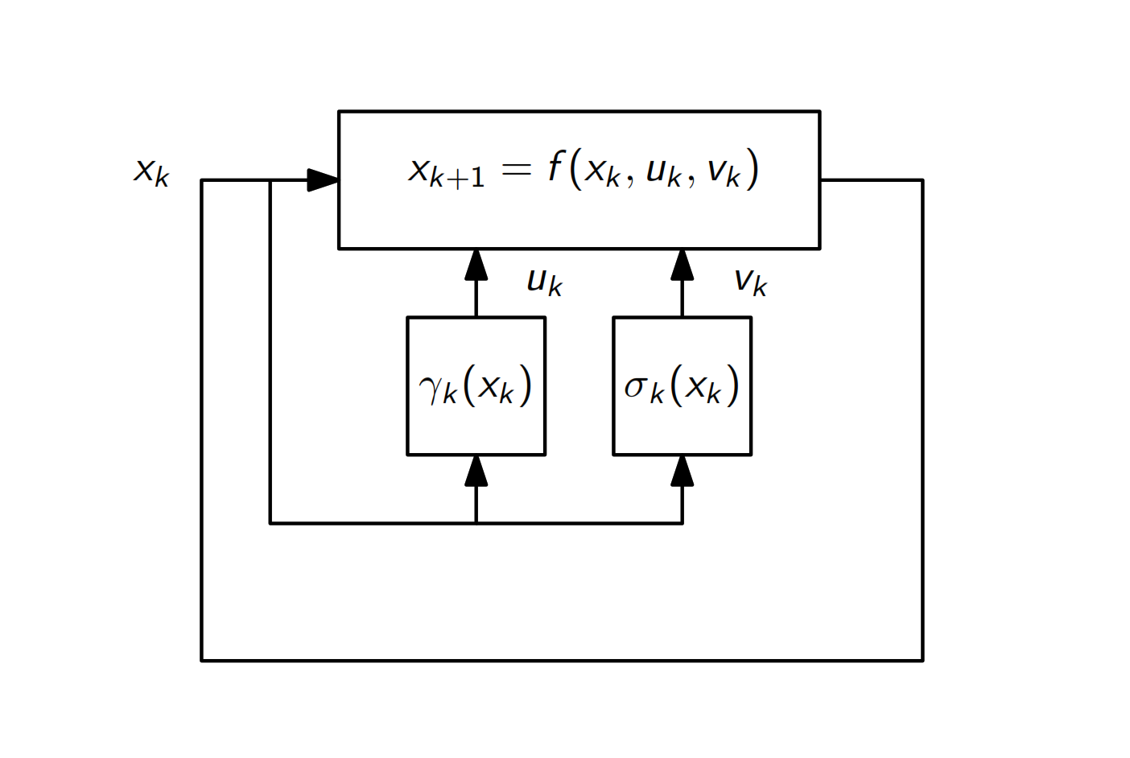
Feedback Game
Framework
Strategy
a state of the game x_{k} that evolves according
outcome is stage-additive
assuming simultaneous decision by the two players

